Slide 1
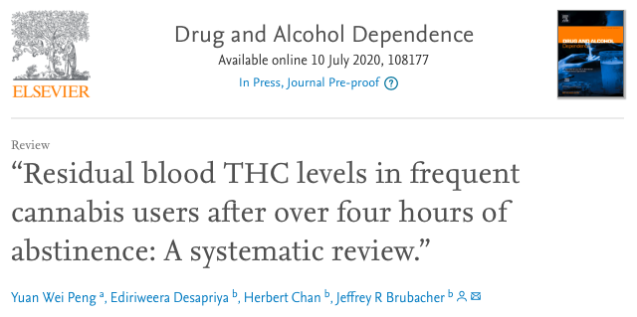
Blood THC does not accurately predict recent cannabis use
This review describes residual blood THC levels in frequent cannabis users after abstinence.

Slide 2
Main point:
Driving under the influence of cannabis can give rise to psychomotor impairment and an increased likelihood of a crash
To minimize these risks, many states have imposed blood THC limits, often 2 or 5 ng/mL, on drivers
However, because THC accumulates in body fat before being slowly released into the bloodstream, regular cannabis users may have high blood THC even after abstaining from cannabis
Blood THC is hardly indicative of impairment, yet it leads to the criminalization of unimpaired users behind the wheel

Slide 3
Results:
Although blood THC declined over time, it remained detectable over several days of abstinence
Some frequent cannabis users had blood THC over 2 ng/mL after 6 days of abstinence
Some frequent cannabis users had blood THC over 5 ng/mL after 1 day of abstinence

Slide 4
Conclusions:
Blood THC is not a reliable indicator of recent cannabis use
In other words, frequent cannabis users with blood THC levels >2 ng/mL and >5 ng/mL did not necessarily use cannabis recently

