Slide 1
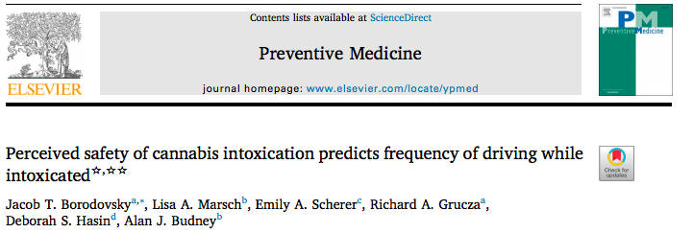
Those who perceive higher levels of intoxication to be safe for driving are more likely to DUIC
This study evaluates how perceived safety relates to one’s likelihood of driving under the influence of cannabis

Slide 2
Main point:
Legalization of cannabis has made its usage, including while driving, more common among the general population
Most cannabis users believe that driving under the influence of cannabis is less dangerous than driving under the influence of alcohol
But many others believe DUIC is safe, and some even believe DUIC is safer than driving while sober.
Because THC impairs psychomotor functioning, driving under the influence of cannabis (DUIC) is a public safety concern that calls for research and intervention

Slide 3
Results:
Those who used cannabis more frequently were more likely to report DUIC in the past month and disclose DUIC at higher levels of intoxication
On a scale of 0 (“Sober”) to 10 (“So high that you throw up”), those with no DUIC in the past month perceived an intoxication level of 3 to be safe for driving while those with DUIC on 20-30 days of the past month perceived an intoxication level of 8 to be safe
The greater the level of intoxication an individual perceived to be safe, the more likely the individual frequently DUIC
Increasing the level of intoxication perceived as safe by 1 made DUIC 20-30 days in the past month 68% more likely

Slide 4
Conclusions:
DUIC patterns varies greatly among cannabis users
The intoxication level perceived as safe for driving is a good predictor of how frequently a person DUIC in the past month
An individual’s usual level of intoxication is not as relevant in predicting frequency

