Slide 1
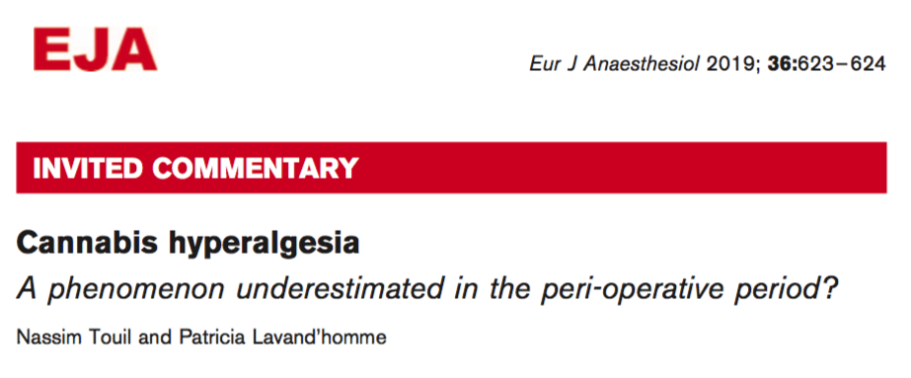

Cannabis may complicate pain management
This commentary highlights two recent studies that evaluate the effect of cannabis usage prior to surgery on post-operative pain management.

Slide 2
Main point:
Standard narcotic treatment of pain after surgery is considered suboptimal
Studies have shown that the use of opioids before surgery to treat severe pain hinders recovery
There is an increased prevalence of cannabis and cannabinoid usage globally, including for pain management
It makes sense to evaluate whether marijuana has similar effects to opioids on post-operative recovery

Slide 3
Results:
According to a study by Jamal et al., marijuana users who underwent abdominal surgery needed a higher dosage of morphine to manage their pain than non-users
According to a study by Liu et al., marijuana users who underwent orthopedic surgery experienced more pain than non-users when consuming the same amount of opioids.

Slide 4
Conclusions:
The use of cannabis and cannabinoids complicates postoperative pain management
The use of marijuana prior to surgery appears to have some negative correlation with the effectiveness of opioids to treat pain
In terms of being used as a painkiller, marijuana suffers limitations
Further research is needed to explore the relationship between the use of marijuana and the management of pain

