Slide 1
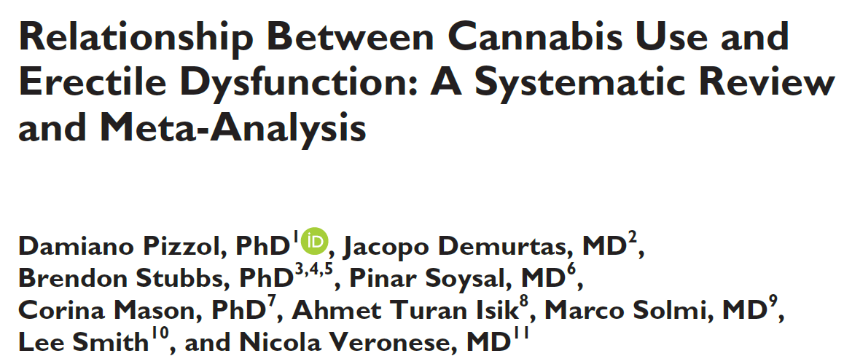
Does cannabis use affect sexual health in men?
American Journal of Men’s Health, 2019

Slide 2
Main point:
It is unclear if cannabis use impacts sexual health in men.
With increasing cannabis legalization, it is essential to identify any associations between cannabis use and erectile dysfunction (ED).
The aim of this meta-analysis was to understand the prevalence of ED among cannabis users compared to non-users.

Slide 3
The study:
The authors conducted a systematic review of major scientific databases (e.g PubMed) until January 2019, to identify studies that investigated cannabis use and presence of ED.
The primary goal was to compare the prevalence of ED in cannabis users versus non-users.

Slide 4
Results:
The authors identified 5 case-control studies that characterized ED among cannabis users.
This yielded data from 3,395 healthy men: 1,035 were cannabis (smoking) users and 2,360 were nonusers.
ED was almost 2-fold more prevalent among cannabis users compared to non-users (69% in users vs. 35% in nonusers).

Slide 5
Conclusions:
The main conclusion from this study was that ED was nearly 2-fold more prevalent among men who used cannabis, compared to non-users.

