Slide 1
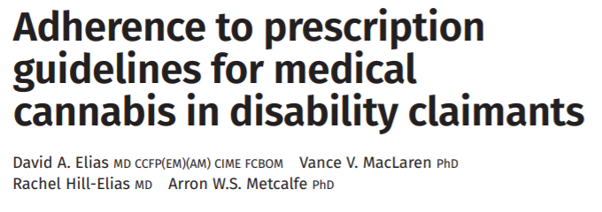

Compliance to Cannabis Prescription Guidelines
This study examines physician adherence to medicinal cannabis prescription guidelines for chronic pain and PTSD

Slide 2
Main point:
Indiscriminate prescription of medical cannabis can lead to unwanted side effects or substance abuse problems
Guidelines have been issued in order to aid in the appropriate prescription of medicinal cannabis, but implementation of these guidelines appears to be highly inconsistent.
Patients seeking insurance coverage for cannabis prescriptions were referred to a private clinic as part of a standard prescription review.
Compliance with indications and contraindications was assessed.

Slide 3
Results:
70 patients were included in the study (61 patients for chronic pain, 9 for PTSD cannabis prescriptions).
 | Chronic Pain (n=61) | PTSD (n=9)
Indications not met (%) | 73.7 | 94.4
Contraindications present (%) | 70.5 | 33
Cautions present (%) | 95.1 | 100

Slide 4
Conclusions:
Only a fraction of cannabis prescriptions followed published guidelines.
Prescription compliance should be emphasized in an effort to comply with basic principles of therapeutics and ensure safe use of medical cannabis.

