Slide 1
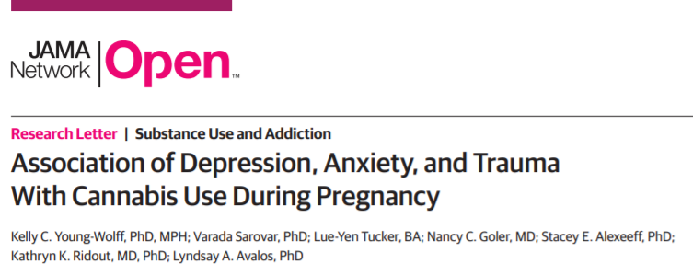



Cannabis use during Pregnancy
This study aims to evaluate the rate of use during pregnancy and the relationship with psychiatric disorders

Slide 2
Main point:
Qualitative studies have determined that there is an increasing trend of cannabis use, especially among patients with co-existing mood or anxiety disorders.
However, no quantitative studies have examined this.
Clinical records at a large private health system were reviewed from 2012 through 2017.
Pregnant patients who completed a self-reported cannabis consumption questionnaire as well as a urine toxicology screen at 8 weeks gestation, were included in the study.

Slide 3
Results:
A total of 196,022 patients were included in the study.
6% of patients (n=11,681) screened positive for prenatal cannabis use.
Demographic factors associated with increased cannabis use:
  Younger age
  Lower household incomes
  African American or Hispanic

Slide 4
Results:
Comorbidities associated with increased cannabis use - adjusted OR (95% CI):
  Anxiety Disorder – 1.90 (1.76-2.04)
  Depressive Disorder – 2.25 (2.11-2.41)
  Anxiety and Depressive Disorder – 2.65 (2.46-2.86)
  History of trauma – 2.82 (2.59-3.06)
  Self-reported intimate partner violence – 1.94 (1.74-2.15)
  Severity of depressive symptoms (self-reported)
    Mild – 1.60 (1.53-1.67)
    Moderate – 2.09 (1.96-2.23)
    Moderately Severe-Severe – 2.55 (2.35-2.77)

Slide 5
Conclusions:
A significant proportion of women used cannabis during pregnancy. Depression, anxiety, history of trauma and intimate partner violence were associated with increased odds of cannabis consumption.
This study provides qualitative evidence that cannabis consumption is prevalent, albeit only in a single health system. Further studies are warranted to confirm this finding.

