Slide 1
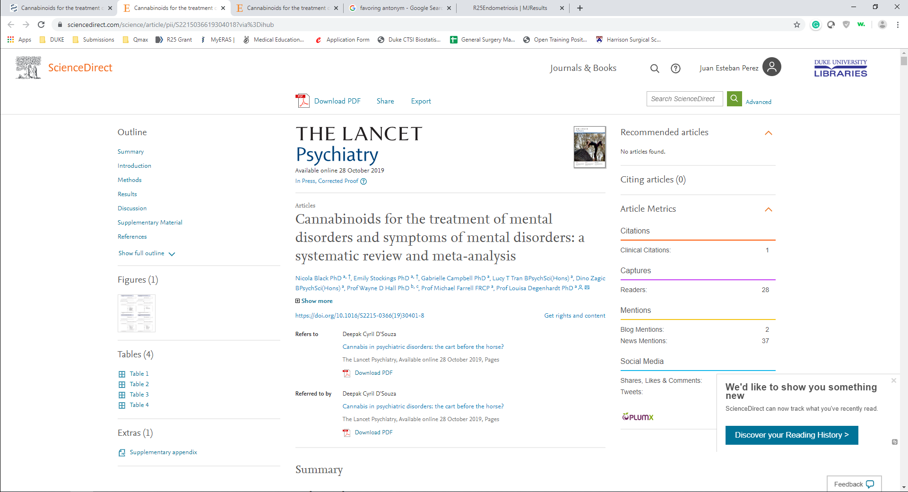



Role of Medicinal Cannabis in Mental Disorders
This study aims to evaluate current evidence regarding the use of medicinal cannabis for the treatment of mental disorders.

Slide 2
Main point:
Mental disorders are the second leading cause of medicinal cannabis prescriptions.
Evidence in this matter is highly inconsistent, and there are no clear recommendations or guidelines that the define the role of cannabis for these conditions
This study aimed to analyze available literature regarding the use of cannabinoids in the treatment of certain mental conditions, in order to evaluate the quality of this evidence and provide improved recommendations for care.

Slide 3
Results:
Literature review for medicinal cannabis (natural/synthetic) for the treatment of depression, anxiety, ADHD, Tourette’s syndrome, post-traumatic stress disorder (PTSD) and psychosis
83 Studies found (50 Randomized Controlled Trials)
  Studies were grouped by condition
  Quality of Evidence assessed using Grading of Recommendations, Assesment, Development and Evaluation (GRADE) methodology

Slide 4
Results:
Inconclusive results
Low/Very Low Quality of Evidence
No evidence favors use of cannabis in:
  Depression
  ADHD
  Tourette's Syndrome
  PTSD
  Psychosis
Contradicting evidence for use in anxiety disorders

Slide 5
Conclusions:
The main conclusion drawn from this exhaustive study is that there is a lack of high-quality data regarding the use of medicinal cannabis for the treatment of mental disorders.
there is a dire need for the development of high-quality research protocols, in order to properly define the role that cannabis has as a treatment option for mental disorders.

