Slide 1
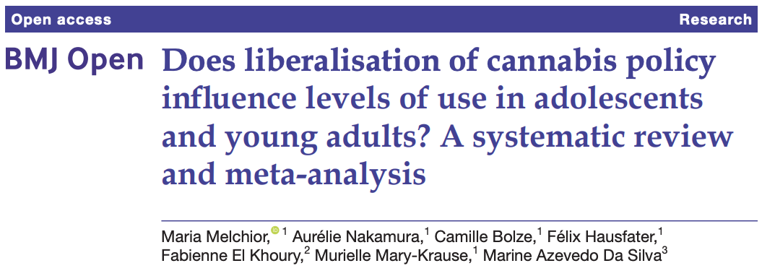

Cannabis consumption in adolescents and young adults following policy changes
This study examines the published evidence regarding changes in cannabis consumption of adolescents and young adults, after changes in legislation.

Slide 2
Main point:
Cannabis policy is quickly changing
Multiple countries and several US states are adopting cannabis decriminalization, legalization for medical use and even legalization for recreational use
In adults, evidence shows that these changes resulted in an increased level of marijuana consumption
There is a lack of evidence about the effects that policy changes have on use by adolescents and young adults (age < 25 years old)

Slide 3
Results:
Policy change | Number of studies | Conclusion
Decriminalization | 13 | No statistically significant changes in consumption levels
Legalization for medical use | 20 | No statistically significant changes in consumption levels
Legalization for recreational use | 8 | Slight increase in consumption levels

Slide 4
Conclusions:
Legalization of cannabis for recreational use does appear to lead to an increased consumption in adolescents and young adults, while decriminalization and legalization for medical use does not.
The results obtained suggest that policy changes must be carefully implemented to protect this high-risk population.

