Slide 1
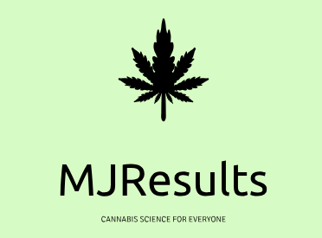
Cannabis use in Multiple Sclerosis
This study aims to evaluate current trends in the use of medicinal cannabis for symptoms of Multiple Sclerosis

Slide 2
Main point:
Multiple Sclerosis (MS) is a chronic and debilitating medical condition that affects close to 800,000 people in the USA
Studies have found that cannabis is effective in relieving pain and spasticity, two of the most common symptoms among MS patients.
Despite the benefit of medicinal cannabis in the management of MS symptoms, little is known about how many patients are aware of this treatment alternative of the respective availability due to individual state legislation.
This study aimed to elucidate the current status of medicinal cannabis among patients with MS in the USA and Canada.

Slide 3
The Study
Can Do MS (Non-Profit Organization) hosted an informational webinar for patients with MS in the United States and Canada. During the webinar, a 3 question survey was administered to participants:
Have you ever used marijuana to help control your MS symptoms?
Have you used marijuana in the past year to help control your MS symptoms?
Do you live in a state where medical marijuana is legal?
A total of 1,015 patients participated in the webinar.
600 patients completed at least one of the questions administered.

Slide 4
Results:
29.6% reported using marijuana to help control their MS symptoms
23.7% reported cannabis use for MS symptoms within the past year.
63% of the patients who answered reported that they live in a state where medical marijuana is legal.
Cannabis use highest in places where cannabis was legal for medical and recreational use (OR 4.55; 95% CI 1.70 – 12.14)
Cannabis use increased 6% with every year after legalization in the corresponding states (OR 1.06; 95% CI 1.02 – 1.10).
Patients with more severe symptoms of MS had increased odds of cannabis consumption (3.41; 95% CI 1.23-9.46)

Slide 5
Conclusions:
The main conclusion drawn from this study is that approximately 1 out of 4 people with MS in the USA and Canada have used cannabis as a treatment for their disease.
This is more likely in places where cannabis is legal for medical and recreational use and is, therefore, more accessible.
Increased awareness and education regarding medicinal cannabis as a treatment option can increase the number of people who resort to this novel treatment option.

Slide 6
The participant's accuracy in the knowledge regarding local cannabis legal status was also examined using a regression model. 502 patients answered the legality question, among which 78 (14%) answered incorrectly. Patients who live in areas where cannabis is legal for medicinal and recreational use had higher odds of being correct regarding the legal status (OR 4.98; 95% CI 1.09 – 22.81) compared to states where cannabis is not legal. Patients who live in states where cannabis is legal only for medical use had lower odds of being correct regarding the legal status of cannabis (OR 0.30; 95% CI 0.15 – 0.60) compared to states where cannabis is not legal.

