Slide 1
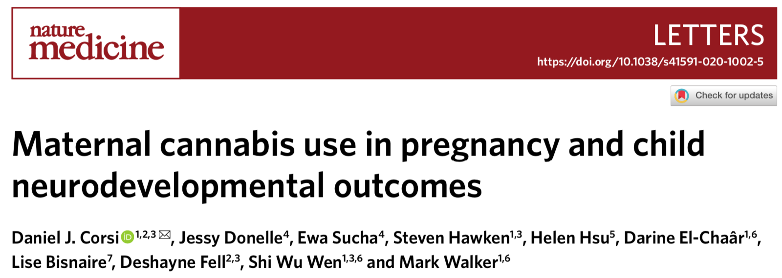
This study looked at the impact of maternal cannabis use during pregnancy and the neurodevelopment of the child
They found an association between maternal cannabis use during pregnancy and an increased incidence of Autism Spectrum Disorder (ASD) or other intellectual/learning disorders in the child
(however these results should be interpreted cautiously)

Slide 2
Main point:
As the legal status of cannabis changes, it is becoming more widely available and more frequently used.
This includes more frequent use by women throughout their pregnancy.
Cannabinoids (the active compounds in cannabis), such as THC, cross the placenta during pregnancy.
Previous research has suggested that exposure to cannabinoids in utero may disrupt the developing fetal neural network.
Therefore, there is concern about the potential impact this may have on the childhood development of the offspring

Slide 3
Results:
This study reviewed data from all live births in Ontario, Canada across a span of 5 years using the BORN Ontario birth registry.
508,025 children were included in the final analysis and data from the provincial health administrative database was used to assess their childhood development.
Factors included in the assessment of neurodevelopmental outcomes were diagnoses of ASD, intellectual and learning disorders, and attention deficit hyperactivity disorder (ADHD).

Slide 4
Results:
The incidence of ASD among children exposed to cannabis in utero was 1.5 times higher than that of children who had no exposure.
Comparing the incidence of ASD across income levels found that income had no effect.
Rates of intellectual and learning disorders were slightly higher (1.2x) among children with prenatal cannabis exposure, however the difference was not significant.
The incidence of ADHD was slightly higher (1.1x) among children exposed to cannabis during pregnancy, but this difference was not significant.

Slide 5
Conclusions:
Prenatal exposure to cannabis appears to result in a higher risk of ASD.
However, these results should be interpreted cautiously, as there may be additional, unidentified, factors playing a role here.

