Slide 1
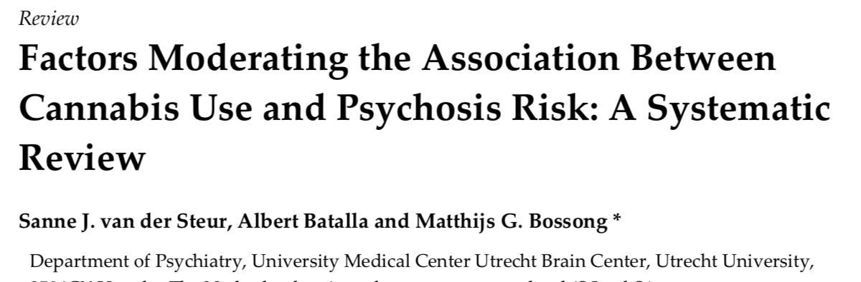
An overview of literature from the last decade concludes that that cannabis use at an earlier age, more frequent (especially daily) use, and high-potency cannabis increased the risk of psychosis
This study provides a detailed and up-to-date review of our understanding about how cannabis use is related to the risk of psychosis

Slide 2
Main point:
Increasing evidence suggests there is a relationship between cannabis use and the risk of psychosis
It is unclear exactly which factors may contribute to this.
This study thoroughly reviews existing literature to determine which determinants may influence the development of psychosis

Slide 3
Results:
Of the 6 studies investigating patterns of cannabis use relative to the development of psychosis symptoms, All found frequent cannabis use, especially daily, to be associated with an increase in psychotic disorders and psychotic-like experiences.
Of the 6 studies looking at the influence of age of first cannabis use on the development of psychosis- all agreed that starting cannabis at a younger age is related to an increased risk of developing psychosis.
22 studies examined the association between cannabis use and the age at which psychosis develops and most found that cannabis use is related to an earlier onset of psychotic symptoms, psychotic experiences or psychotic disorders.

Slide 4
Results:
4 studies reported on the type of cannabis used, in relation to the risk of developing psychosis, and suggest that using high-potency cannabis (cannabis with a higher THC content) significantly increases the risk of developing a psychotic disorder.
3 studies looked at the relationship of genetic background to the risk for developing psychosis. Overall, there is some evidence for an association between some genes involved in dopamine signaling and an increased risk of psychosis. However, a significant number of studies found no association for this.
5 studies investigated the relationship between cannabis use and the transition to psychosis, in individuals at a high clinical risk and found that frequent cannabis use, cannabis dependence, or lifetime cannabis abuse increases the risk of transition to psychosis in these individuals.

Slide 5
Conclusions:
Overall, the studies reviewed here show that there is an association between cannabis use and developing psychosis.
The strongest evidence links the frequency and potency of cannabis use to a higher risk for psychosis.
Studies also suggest that earlier use of cannabis is associated with an earlier onset of psychosis.
There is also evidence that the genetic background of an individual can affect this risk,

