Slide 1
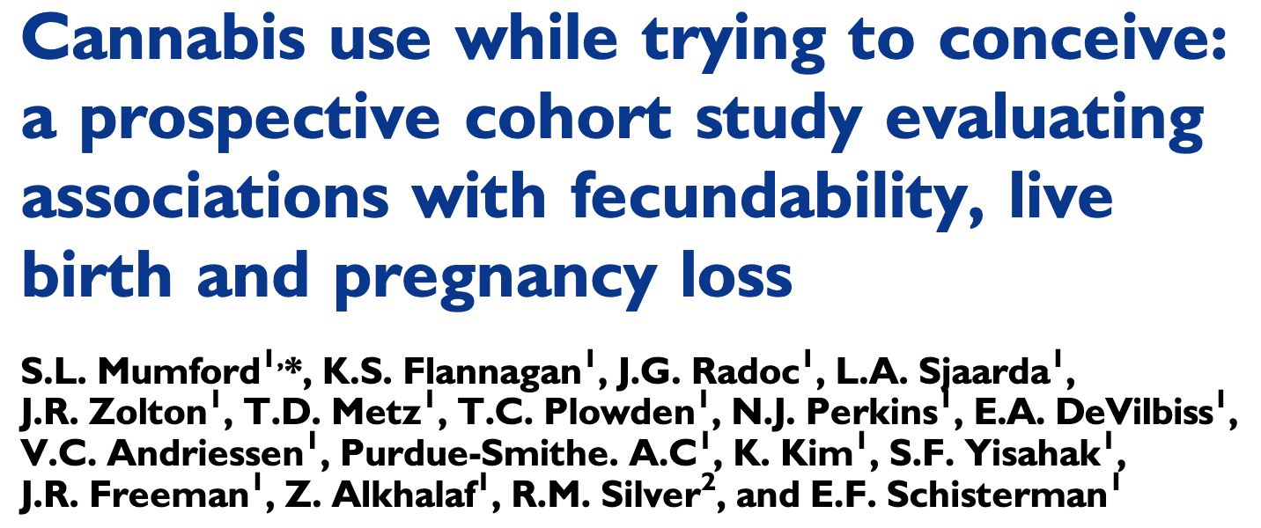

This study looked at whether cannabis use prior to conception is associated with fecundity, live birth and pregnancy loss
The authors found that preconception cannabis use was associated with reduced fecundability

Slide 2
Main point:
Cannabis use continues to increase but we don’t know very much about how safe it is during the critical windows of time that pregnancy is established.
Some existing studies suggest that cannabis use is not associated with fecundability, but these studies are based on self-reported cannabis use, and self-reporting may not always be reliable.

Slide 3
Results:
This study followed 1,228 women with a history of pregnancy loss who were trying to conceive, and monitored their cannabis use through self-reporting at baseline and urine testing afterwards.
In addition, women reported frequency of intercourse and urine samples were also used to measure reproductive hormones (and identify early pregnancy loss.
The women were followed for up to 6 menstrual cycles while they were trying to conceive and throughout pregnancy.
Time to pregnancy, incidence of live birth and pregnancy loss were recorded and fecundability odds ratio were calculated.
Sociodemographic and lifestyle characteristics were compared among those who did and did not use cannabis, and were factored into calculations.
Overall, 5% (62/1228) women used cannabis during the preconception period
More than 50% of participants with positive urine tests did not self-report use

Slide 4
Results:
Of the women who became pregnant, 1.3% used cannabis during their first 8 weeks of pregnancy
42% (26/62) women who used cannabis any time before conception became pregnant
Self-reported cannabis use was associated with a 42% reduction in fecundability; cannabis use determined by urine test was associated with a 47% reduction.
Cannabis use during preconception was associated with increased intercourse per menstrual cycle, higher LH levels and higher LH:LSH ratio.
Cannabis use was suggestive of anovulation, but the association was not statistically significant
Similar impairments were found when considering cannabis use in the 12 months preceding pregnancy, suggesting that past use may influence fecundability, which may not be immediately reversible.
There were no associations between cannabis use during preconception and pregnancy loss.

Slide 5
Conclusions:
Despite the perception that recreational cannabis use is harmless, this study found that, among women with a history of pregnancy loss, cannabis use was associated with impaired fecundability and increased frequency of intercourse.
The authors were unable to estimate any association between cannabis use during early pregnancy and pregnancy loss, due to the limited sample size.
This study adds nothing about the effects that male partner cannabis use may have on reproduction.

