Slide 1
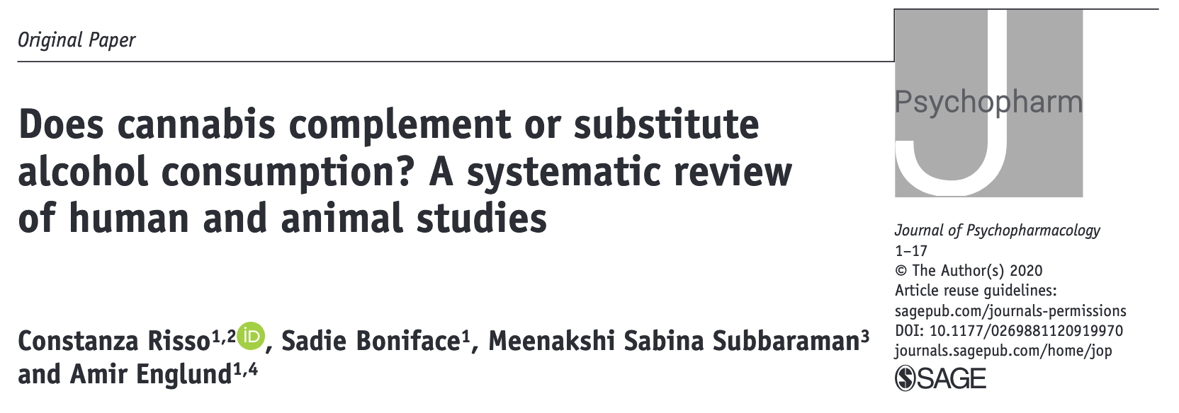
This review discusses the effects of alcohol and cannabis; either in combination, or as substitution for one another.
There have been a number of studies looking at the use alcohol and cannabis as substitutes for one another or in combination, which may have important to understand as cannabis becomes more widely available and new policies are implemented.

Slide 2
Main point:
The question of whether or not the effects of alcohol complement or substitute for the effects of cannabis, continues to be studied and it is important to consider the potential for spill-over effects between these substances as cannabis policy changes.
Some previous reviews have found that legalization of cannabis leads to increased use of cannabis in combination with other substances.
Alcohol has long been recognized as a substance with the potential for significant harm, therefore it is important to understand the potential effects of cannabis use in combination with alcohol.

Slide 3
Results:
This report reviews previous literature and includes new data from animal studies.
65 articles were included in this review; 64 of which were studies in humans and one reported a study in animals.
The analysis of these articles evaluated findings in several categories, including patterns of use, substitution practices, substance use disorders, policy evaluation and animal studies.
This review assessed studies cannabis and alcohol use with the primary goal of evaluating evidence of people substituting one substance for the other or complementary (combined) use of the two.
30 studies found evidence for substituting one substance for the other
17 studies found evidence of complementary use of the two
14 did not find evidence for either substitution or complementarity
Four studies found evidence for both substitution and complementary use

Slide 4
Results:
Studies looking at the impact of legal policy found increased legal drinking age associated with decreased alcohol use but increased cannabis use. Separately, turning 21 (and able to legally purchase alcohol) was linked to decreased cannabis use but increased alcohol use
Differences between complementary and substitution use appear to vary by age, as studies in different age cohorts report different findings
Among former alcoholics or light drinkers, studies found increased alcohol consumption when these people abstained from cannabis use. One study found that recovering alcoholics were more likely to relapse when using cannabis
Studies looking at the impact of decriminalization on substitution found different results, depending on the population being studied
Some studies show that increasing the price of alcohol reduces both alcohol and cannabis use in adolescents
One animal study suggested cannabinoids might have potential use in treating alcohol use disorders

Slide 5
Conclusions:
This analysis finds mixed support for substitution and complementary use of alcohol and cannabis, however it finds stronger support for substitution
However this may be a result of bias in the studies, as most were conducted with the goal of researching substitution in the context of policy changes.
This study does not tell us much about the preference of users for substitution or complementary use, in the absence of a policy change to drive their decision.
This study highlights areas where were need more research, particularly as related to the more recent, and rapid, changes in cannabis policy

