Slide 1
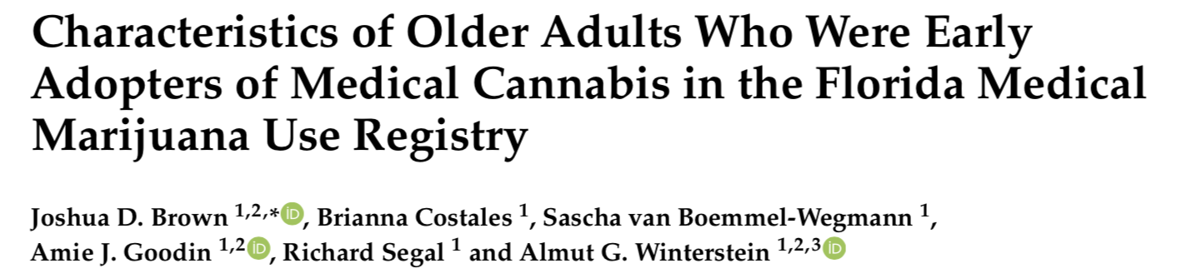
This study provides a descriptive analysis of older adults who were early participants in Florida’s cannabis program.
This report analyzes treatment and follow-up of older adults prescribed medical cannabis, including information on a number of different demographic, medical and health indicators

Slide 2
Main point:
Cannabis use is increasing throughout the US, and the fastest growing user group is adults aged 50 years or older
Patients in this older age group tend to be more medically complex than younger individuals
We don’t know much about the characteristics and outcomes related to cannabis use in older individuals.
This retrospective study analyzed data collected from patients enrolled in a medical cannabis program in Florida; including demographics, clinical history, medical conditions, substance use history, prescription history, and health status

Slide 3
Results:
The study reviewed follow up treatment plans for any changes in medical complaints or changes in treatment since the initial visit- Data was analyzed from initial and follow-up treatment plans submitted to the University of Florida College of Pharmacy
7548 total treatment plans submitted from Aug 2016 to July 2017, 4447 fit the age group of older adults, and were analyzed in this study
45% of patients used cannabidiol (CBD)-only preparations, 33% used preparations that had both tetrahydrocannabinol (THC) and CBD, while 21.7% used both CBD-only and THC + CBD products
The main complaints that warranted the prescription of cannabis were pain-related: musculoskeletal disorders and spasms accounted for 48.4% of prescriptions and 45.4% used it for chronic pain.
Cancer was an indication for 15.5% of all patients

Slide 4
Results:
On average, patients used roughly 2.5 other medications, in addition to cannabis: 23.8% of patients also used antidepressants, 23.5% used anxiolytics and benzodiazepines, 28.6% used opioids, and 27.9% also used cardiovascular agents.
27.5% of patients showed significant improvement (as reported by physician assessment) in their complaint; less than 3% reported worsening conditions
Adherence to treatment plans appears to be low, as only 27.5% of patients recorded a second follow up visit.
Some patients reported notable changes in medication regimens including stopped opioid medications, improved sleep quality, reduction of medications for sleep, and reduced use of anxiety medications
The patient registry did not have enough details to thoroughly assess safety or efficacy of cannabis treatment

Slide 5
Conclusions:
This study provides a descriptive analysis of older adults using cannabis- a growing, but understudied population
It summarizes the chief complaints leading to the prescription of medical cannabis and usage habits of patients.
It indicates that improvements to registries are necessary to allow for the study of efficacy and safety of cannabis treatments.

