Slide 1
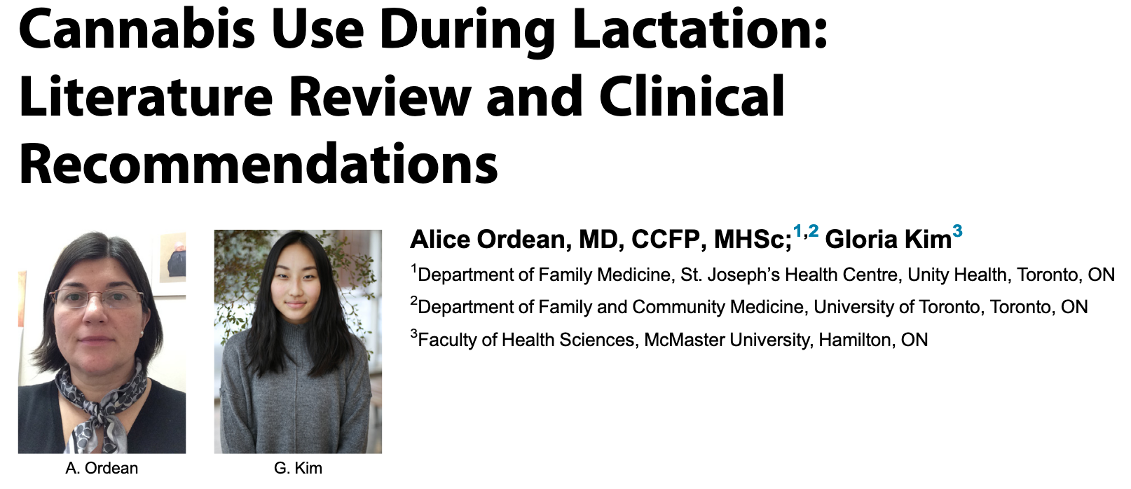
Breastfeeding women should abstain from, or at least diminish, cannabis use to prevent exposing infants to cannabinoids in breast milk
This study performs a thorough literature review of evidence regarding the effects of exposure to cannabis in breast milk on infants

Slide 2
Main point:
One active ingredient in cannabis, THC, accumulates to high concentrations in breast milk.
Nursing infants can be acutely exposed to high levels of THC while feeding
We don’t know what potential impact that might have on infant development.
This article reviewed studies that addressed the impact of postpartum cannabis use by lactating women, and which studied developmental outcomes for infants – two studies met the inclusion criteria

Slide 3
Results:
A total of 150 mother-infant pairs were included, between the two studies
One study found that there were no significant differences in the mental or motor development of infants on the basis of post-natal cannabis exposure
This study also found that comparisons based on the level or length of prenatal cannabis exposure did not show any association between maternal prenatal cannabis use and infant developmental scores
The second study found that average motor development scores were significantly lower for infants who had been exposed to cannabis for more than half of the first trimester of pregnancy or during the first month of lactation, but use during the third month of lactation did not have a significant impact.
Both studies agreed that maternal cannabis use during pregnancy and lactation was not associated with differences in infant mental development at 1 year of age
The two studies had different findings with respect to cannabis effects on motor development- one did not find any difference in development, while the other reported a difference in development depending on the level of cannabis exposure

Slide 4
Conclusions:
Clinical recommendations based on these studies:
Pregnant women should be counseled about potential risks of postpartum cannabis use to infant health, including shorter duration of breastfeeding and possible neuro-developmental delays.
Women who are breastfeeding should be advised to abstain from cannabis use and other co-exposures such as alcohol and tobacco during lactation.
If abstinence is not possible, mothers should be advised to reduce cannabis use
To reduce the risk of exposure to the highest concentration of THC in breast milk, women should avoid breast- feeding within 1 hour of inhaled cannabis use
There is some evidence that cannabis use during nursing can have a detrimental effect on infant development.
In order to develop the best recommendations for cannabis use while nursing, the possible effects of infant exposure to THC in breast milk need to be more thoroughly investigated

