Slide 1
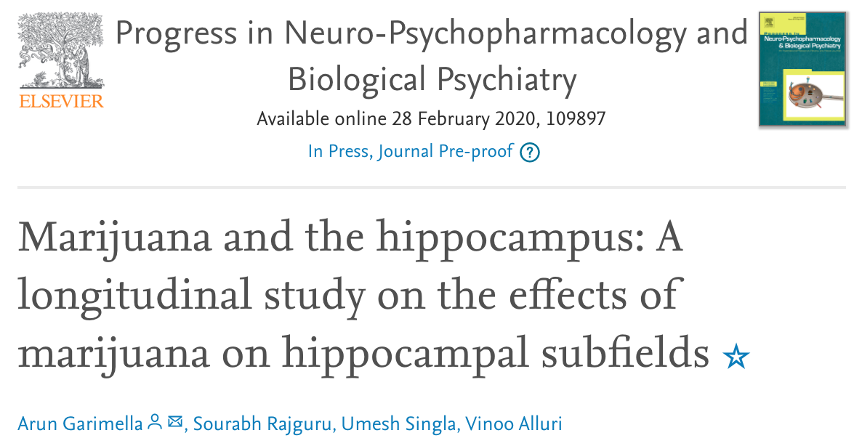
This study shows that long-term cannabis use does not lead to changes in the volume of the hippocampus as a whole, but may lead to differences in the development of subfields within the hippocampus.
This study uses data from a previous study to analyze the long-term effects of cannabis use on subfields of the hippocampus.

Slide 2
Main point:
The psychoactive effects of cannabis have been extensively documented, and cannabis use has been linked to a number of psychiatric conditions.
Decreased grey matter in the hippocampus has also been associated with many of these same conditions
However, there have been few studies looking at the effects of long-term cannabis usage on the hippocampus.

Slide 3
Results:
This study uses data from a previously published study, which evaluated the differences in hippocampus between cannabis users and healthy controls by comparing results of Cannabis Usage and Disorder Identification Test (CUDIT) (to establish usage habits) and structural MRI scans (to examine the hippocampus).
Over a period of 3 years, the scans compared the volume of the hippocampus between these two groups.
This study it provides a more thorough evaluation than previous published because it evaluates different subfields of the organ separately.
The study evaluated 23 healthy controls and 20 heavy cannabis users.

Slide 4
Results:
Overall, this study agrees with previous findings: that there is no significant difference in hippocampus volume between cannabis users and healthy controls, when considering the hippocampus as a whole
While analysis of most subfields was the same between the two groups, this study did find differences in certain subfields of the hippocampus:
There was a greater increase in the volume of the right hemispheric parasubiculum and fimbria in cannabis users.
There was also an increase in the volumes of the CA3 in both hemispheres for cannabis users.
This study found that continued cannabis use did not result in hippocampus changes that could be distinguished from non-users.

Slide 5
Conclusions:
Long-term cannabis usage does not lead to significant changes in the size of the hippocampus, as a whole.
However, this study suggests that certain subsections of the hippocampus may develop differently as a result of cannabis usage.
It shows that there may be differences at these sub-levels which are not apparent when evaluating the hippocampus as a whole

